Slide 1
CSCE 3600 Principles of Systems Programming Interprocess Communication Part 1
University of North Texas

Slide 2

Interprocess Communication

Slide 3

Interprocess Communication
Processes may be independent or cooperating
An independent process cannot affect or be affected by the execution of another process
A process that does not share data with another process is independent
A cooperating process can affect or be affected by the execution of another process
A process that shares data with another process is a cooperating process
Cooperating processes require interprocess communication (IPC)

Slide 4
Cooperating Processes
Why provide an environment for cooperating processes?
Information sharing
Cooperating processes can share information (such as access to the same files) among multiple processes, but a mechanism is required for parallel access
Modularity
Involves dividing complicated tasks into smaller subtasks, which can be completed by different cooperating processes
Computation speedup
Subtasks of a single task can be performed in parallel using cooperating processes
Convenience
Different tasks completed/managed by cooperating processes

Slide 5
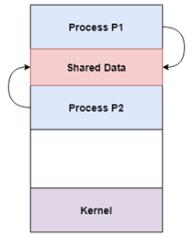
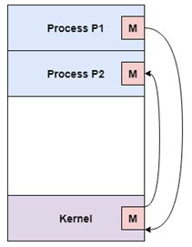
Methods of Cooperation
Cooperation by sharing
Use shared data such as memory, variables, files, databases, etc. mutually exclusive
Critical section used to provide data integrity with mutually exclusive writing to prevent inconsistent data
Cooperation by communication
Cooperation using messages (message passing)
May lead to deadlock if each process waiting for a message from the other to perform an operation
Starvation also possible is process never receives a message
We will focus on message passing in this class

Slide 6

Message Passing
A mechanism is needed for processes to communicate and synchronize their actions
In a message system, processes communicate with each other without resorting to shared variables
IPC facility provides two primitive operations for fixed or variable-sized message passing: send and receive
If two processes wish to communicate, they need to
Establish a communication link between them
Logical (e.g., logical properties) or physical (e.g., shared memory, hardware bus)
Exchange messages via send/receive

Slide 7
Synchronizing Messages
Message passing may be either blocking or non-blocking
Blocking is considered to be synchronous
Send sender blocked until message received
Receive receiver blocks until a message is available
Non-Blocking is considered to be asynchronous
Send sender resumes operation immediately after sending (i.e., send and continue)
Receive receiver returns immediately with either a valid or null message

Slide 8
Buffering
A message queue can be implemented in one of three ways
Zero capacity
No messages may be queued within the link
Requires sender to wait until receiver retrieves message
Bounded capacity
Link has finite number of message buffers
If no buffers are available, then sender must wait if the link is full
Unbounded capacity
Link has unlimited buffer space, so sender never needs to wait

Slide 9
IPC Methods
We will explore the following IPC methods
Signaling
As a limited form of IPC, a signal is essentially an asynchronous notification sent to a process in order to notify it of an event that occurred
Files
A file is a durable block of arbitrary information, or resource for storing information
Pipes
A pipe is a synchronized, interprocess byte stream
Sockets
Sockets provide point-to-point, two-way communication between two processes, even processes on different systems
int socketfd = socket(AF_UNIX, type, protocol);

Slide 10
Signal Handling

Slide 11
What Are Signals?
A signal is a software interrupt
Notification of an event
A way to communicate information to a process about the state of other processes, the OS, and hardware so that the process can take appropriate action
Can change the flow of the program
When a signal is delivered to a process, process will stop what it’s doing – and either handle or ignore signal
Signals can be delivered in an unpredictable manner
Originate outside of currently executing process
Asynchronous events due to external trigger at the hardware or OS level – causes a context switch!

Slide 12
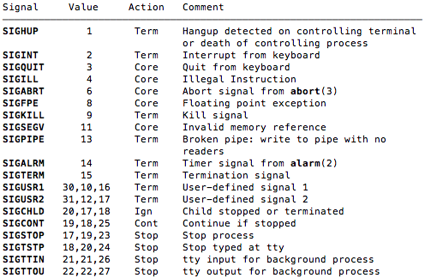
What Are Signals?
Every signal has a name that starts with SIG, a value, a default action, and a description
See man 7 signal
Defined in sys/signal.h

Slide 13
Default Action of Signals
Each signal has a default action
Term the process will terminate
Core the process will terminate and produce a core dump file that traces the process state at the time of termination
Ign the process will ignore the signal
Stop the process will stop, like Ctrl-Z
Cont the process will continue from being stopped

Slide 14
Flow of Signals
Event gains attention of OS
OS stops process execution immediately
Sends it a signal
Signal Handler then executes to completion
Process execution resumes where it left off
Process
movl
pushl
call f
addl
movl
…
void handler(int iSig)
{
…
}
signal

Slide 15
Signal Events
In the context of terminal signaling, programs can stop, start, and terminate
Ctrl-C is the same as sending SIGINT (2) signal
Default handler exits process
Ctrl-Z is the same as sending a SIGSTOP (20) signal
Default handler suspends process
Ctrl-\ is the same as sending a SIGQUIT (3) signal
Default handler exits process
Typing fg or bg at the terminal is the same as sending a SIGCONT (18) signal to bring or send a process to the foreground or background, respectively

Slide 16
Signal Events
Signals are notification of events
We can inject signals, such as Ctrl-C, to gain the attention of the OS and stop the process by sending a SIGINT signal
But some are done internally, such as when a process makes an illegal memory reference
Event gains attention of the OS
OS stops process execution immediately, sending it a SIGSEGV (11) signal
Signal handler for SIGSEGV signal executes to completion
Default signal handler for SIGSEGV signal prints “segmentation fault” generates a “core dump” and exits process

Slide 17
Signal Handling
Each signal type has a default handler
Most default handlers exit the process
A program can install its own handler for signals of almost any type
Cannot install its own handler for the following signals
SIGKILL (9)
Default handler exits the process
Catchable termination signal is SIGTERM (15)
SIGSTOP (19)
Default handler suspends the process
Can resume the process with signal SIGCONT (18)
Catchable suspension signal is SIGTSTP (20)

Slide 18
Basic signal management
signal() function --- oldest interface for signal management
#include <signal.h>
typedef void (* sighandler_t) (int);
sighandler_t signal(int iSig, sighandler_t pfHandler);
Successful call to signal() removes the current action taken on receipt of the signal iSig, and instead handles the signal with the signal handler specified by pfHandler
iSig is one of the signal names such as SIGINT or SIGUSR1 (see the 31 signal names)
The handler function must return void, because there is no standard place in the program for this function to return
The handler function takes one argument, an integer, which is the signal identifier (for e.g. SIGUSR2) of the signal being handled. This allows a single function to handle multiple signals

Slide 19
Installing a Signal Handler
sighandler_t signal(int iSig, sighandler_t pfHandler);
Installs pfHandler as the handler of signals for type iSig
pfHandler is a function pointer
typedef void (* sighandler_t) (int);
Returns the old handler on success; SIGERR on error
After call, pfHandler is invoked whenever process receives a signal of type iSig

Slide 20
Signal Handler Example
#include <stdio.h>
#include <assert.h>
#include <signal.h>
void myHandler(int iSig) {
printf(“The program is in myHandler with argument %d\n", iSig);
}
int main() {
void (*pfRet)(int) = signal(SIGINT, myHandler);
assert(pfRet != SIG_ERR);
printf("Entering an infinite loop\n");
while (1) {
printf(".");
}
return 0;
}

Slide 21
Signal Handler Example (using delay)
#include <stdio.h>
#include <assert.h>
#include <signal.h>
#include <unistd.h>
void myHandler(int iSig) {
printf("Program is in myHandler with argument %d\n", iSig);
}
int main() {
void (*pfRet)(int) = signal(SIGINT, myHandler);
assert(pfRet != SIG_ERR);
printf("Entering a loop with delay\n");
for (int i = 0; i < 10; i++) {
printf(".");
fflush(stdout); // Ensure the dot is immediately printed
sleep(1); // Introduce a 1-second delay
}
return 0;
}

Slide 22
Predefined Signal Handlers
Can install predefined signal handler SIG_IGN to ignore signals
void (*pfRet)(int) = signal(SIGINT, SIG_IGN);
Subsequently, process will ignore SIGINT (2) signals
Can install predefined signal handler SIG_DFL to restore default signal handler
void (*pfRet)(int) = signal(SIGINT, myHandler);
…
pfRet = signal(SIGINT, SIG_DFL);
Subsequently, process will handle SIGINT (2) signals using the default handler for SIGINT (2) signals

Slide 23
Sending Signals via Command
kill –signal pid
Send signal of type signal to process with ID pid
Specify signal type name (–SIGINT) or number (–2)
Examples:
kill –2 1234
kill –SIGINT 1234
kill –HUP 1722
killall loop
Send a signal to all processes named loop to “terminate”
This will actually send the signal SIGTERM, whose purpose is to communicate a termination request to the given process, which does not necessarily have to terminate
Same as typing Ctrl-C if process 1234 is running in foreground

Slide 24
Sending Signals via System Call
int raise(int iSig);
Instructs OS to send signal of type iSig to current process
Returns 0 to indicate success; non-0 to indicate failure
Example:
int retVal = raise(SIGINT); // process commits suicide
assert(retVal != 0); // should not get here
int kill(pid_t iPid, int iSig);
Sends iSig signal to process with ID iPid
Equivalent to raise(iSig) when iPid is ID of current process
Example:
pid_t iPid = getpid(); // process gets its pid
kill(iPid, SIGINT); // sends itself a SIGINT signal, commits suicide

Slide 25
pause() Function
int pause( );
Suspends the calling process, without wasting resources, until some kind of signal is caught
pause() returns only if the caught signal is received, in which case the signal is handled and pause() returns -1, and sets errno to EINTR
Signal action can be the execution of a signal handler function or process termination
In Linux kernel, pause() is one of the simplest system calls- it performs only 2 actions.
it puts the process in the interruptible sleep state.
it calls schedule() to invoke the Linux process scheduler to find another process to run.
As the process is not actually waiting for anything, the kernel will not wake up unless it receives a signal.

Slide 26
pause() Example
#include <stdio.h>
#include <unistd.h>
#include <signal.h>
void sig_usr( int signo ); /* handles two signals */
int main() {
int i = 0; if( signal( SIGUSR1,sig_usr ) == SIG_ERR ) printf( "Cannot catch SIGUSR1\n" ); if( signal( SIGUSR2,sig_usr ) == SIG_ERR ) printf( "Cannot catch SIGUSR2\n" ); : while(1) { printf( "%2d\n", i ); pause(); /* pause until signal handler * has processed signal */ i++;
}
return 0;
}

Slide 27
pause() Example
/* argument is signal number */
void sig_usr( int signo )
{
if( signo == SIGUSR1 ) printf( "Received SIGUSR1\n" ); else if( signo == SIGUSR2 ) printf( "Received SIGUSR2\n" ); else printf( "Error: received signal %d\n", signo); return;
}
$ sig_examp & [1] 4720 0 $ kill -USR1 4720 Received SIGUSR1 1 $ kill -USR2 4720 Received SIGUSR2 2 $ kill 4720 /* send SIGTERM */ [1] + Terminated sig_examp & $

Slide 28
Send signals to Process groups
Int killpg(int pgrp, int iSig)

Slide 29
Files

Slide 30

Overview of Files
Data communication with a C program and the outside world is performed through files
Files are a non-volatile way to store data by means of such media as tape, CD-ROM, floppy disk, ZIP disk, hard drive, etc.
C (just like the Linux operating system) considers all process communication media to be files
An ordinary file on a disk is considered to be a file
So is the keyboard, the screen, parallel ports, and serial ports

Slide 31

Linux Files
A Linux file is a sequence of m bytes
B₀, B₁, …, B_{k}, …, B_{m-1}
All I/O devices are represented as files
/dev/sda2 (/usr disk partition)
/dev/tty2 (terminal)
Even the kernel is represented as a file
/dev/kmem (kernel memory image)
/proc (kernel data structures)

Slide 32
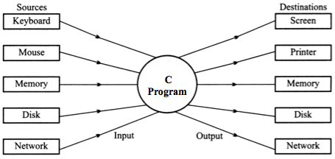
I/O and Data Movement
Input and output share common property of unidirectional movement of data and support to sequential access to data
The flow of data into a program (input) may come from different devices such as keyboard, mouse, memory, disk, network, or another program
The flow of data out of a program (output) may go to the screen, printer, memory, disk, network, another program

Slide 33
Some Linux File Types (Review)
Regular file
Binary or text file (Linux does not know the difference)
Directory file
A file that contains the names and locations of other files
Character special and block special files
Terminals (character special) and disks (block special)
FIFO (named pipe)
A file type used for interprocess communication to exchange data between unrelated processes
Socket
A file type used for network communication between processes

Slide 34

Communication through Files
Storing and manipulating data using files is known as file processing
Programs access files through basic file operations
Open a file
Read data from a file
Write data to a file
Close a file
Text files store all data types as character bytes
The way a program reads the data (either text or binary mode) determines how the data is interpreted
Example: 12 z rti 456.79 room
these “process” a file

Slide 35
Standard I/O Functions
Examples of standard I/O functions:
Opening and closing files (fopen and fclose)
Reading and writing bytes (fread and fwrite)
Reading and writing text lines (fgets and fputs)
Formatted reading and writing (fscanf and fprintf)
FILE* fp;
fp = fopen("In.file", "rw");
fscanf(fp, ……);
fprintf(fp, ……);
fread(………, fp);
fwrite(………, fp);

Slide 36
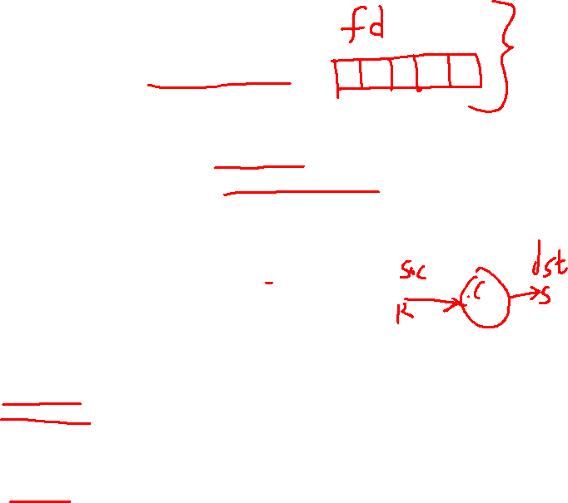
Standard I/O Streams
Standard I/O models open files as streams
Abstraction for a file descriptor and a buffer in memory.
Three files are automatically opened each time a C program is run and automatically closed when a C program ends:
stdin (standard input, default source = keyboard)
stdout (standard output, default destination = screen)
stderr (standard error, default destination = screen)
#include <stdio.h>
extern FILE *stdin; /* standard input (descriptor 0) */
extern FILE *stdout; /* standard output (descriptor 1) */
extern FILE *stderr; /* standard error (descriptor 2) */
int main() {
fprintf(stdout, "Hello, world\n");
}
streams
file descriptors

Slide 37

Buffering in Standard I/O
Standard I/O functions use buffered I/O
printf("h");
printf("e");
printf("l");
printf("l");
buf
printf("o");
printf("\n");
h
e
l
l
o
\n
.
.
fflush(stdout);
write(1, buf += 6, 6);

Slide 38
Standard I/O Buffering Example
You can see this buffering using the Linux strace program:
#include <stdio.h>
int main()
{
printf("h");
printf("e");
printf("l");
printf("l");
printf("o");
printf("\n");
fflush(stdout);
return 0;
}
linux> strace ./hello
execve("./hello", ["hello"], [/* ... */]).
...
write(1, "hello\n", 6...) = 6
...
_exit(0) = ?

Slide 39
File Descriptors
Each open file is associated with an open file description
An OS internal record of how a process or group of processes are currently accessing a file that includes
File offset indicates byte position where next I/O operation begins
File status indicates append mode/not, blocking/non-blocking, etc.
File access mode indicates whether file can be read or written
Each process has a logical array of references to open file descriptions
Logical indices into this array are file descriptors used to identify the files for I/O operations
A file descriptor does not describe a file – it’s just a number ephermerally associated with a particular open file description
List open files: lsof –p <pid>

Slide 40
File Descriptors
Other descriptors are assigned by system calls to open/create files, create pipes, or bind to devices or network sockets
E.g., pipe(), socket(), open(), creat()
A common set of system calls operate on open file descriptors independent of their underlying types
E.g., read(), write(), dup(), dup2(), close()

Slide 41

Files as Pipes for Data
Files act as pipes to bring a stream of data into the program and send a stream of data out of the program
The program reads data from stdin and writes data to stdout as if they were ordinary files
45 27 15 52
Program
to compute
average
Average is 34.75
stdin
stdout

Slide 42
One Byte at a Time
Data is read or written one byte at a time from a file until the end of the file is reached or until the file is closed
The file system uses a pointer to keep track of the next byte to read or to write
In this file, the program has read the data as far as the letter 'J'. The next character to be read is 'a'
Smith Jack 1045.76 Manager 15
Hanson Susan 98.62 Operator 7
Jones Nancy 790.25 Administrator 10
Doe Carl 526.71 Technician 12

Slide 43

Functions Using stdin and stdout
Some standard C functions implicitly use stdin and stdout
scanf("%d", &aNumber);
aSymbol = getchar();
gets(theBuffer); // High security risk
printf("Average: %5.2f", theAverage);
putchar(aCharacter);
puts(aPhrase);

Slide 44
Functions Using stdin and stdout
Other functions need to have stdin and stdout specified as the file descriptor
fscanf(stdin, "%d", &aNumber);
aSymbol = fgetc(stdin);
fgets(theBuffer, sizeof(theBuffer), stdin);
fprintf(stdout, "Average: %f", theAverage);
fputc(aCharacter, stdout);
fputs(aPhrase, stdout);

Slide 45
Recap
OS has the responsibility of your files
In the lowest level, the OS identifies files using an i-number, which when paired with a major/minor number of the physical device tells it in a unique way saying which file stored on any disk within the entire computer system
The combo of i-number + major/minor number is for the OS as the filename is to a human
The idea of PATH describes to the OS how to identify a specific human name for any file in the system i.e /x/y/z – translates to specific set of blocks on a storage device

Slide 46
Recap
When each program performs the I/O the program could hand the OS the PATHNAME for specific files
Instead it could hand a file descriptor or fd
When a process is going to need access (R/W) to a file, it hands the OS, the PATHNAME.
The OS translates the PATHNAME into a unsigned integer (file descriptor)
fd is a small integer that is passed around from a user process to the kernel to easily identify what specific ‘open file’ the [processes desires to have the I/O performed
UNIX OS calls it a fd WINDOWS OS calls it a handle

Slide 47
Pipes

Slide 48

What is a Pipe?
A pipe is a simple, synchronized way of passing information between processes
A pipe is a special file/buffer that stores a limited amount of data in a FIFO (i.e., sequential) manner
Pipes are commonly used from within shells to connect stdout of one utility to stdin of another
Pipes provide a basic level of synchronization
If a process tries to write to a full pipe, it is blocked until the reader process consumes some data
If a process tries to read from an empty pipe, it is blocked until the writer produces some data
Data is written to and read from the pipe using the unbuffered system calls write() and read()

Slide 49

Two Types of Pipes
Unnamed pipes
Not associated with any file
Can only be used with related processes, e.g a parent & child process
Exist only as long as the using processes are not terminated and support unidirectional communication
Created using the pipe() system call
Named pipes, or FIFOs
Associated with a file and can be used with unrelated processes
Has a directory entry with file access permissions
Can support bidirectional communication
Created using the mknod() or mkfifo() system calls

Slide 50
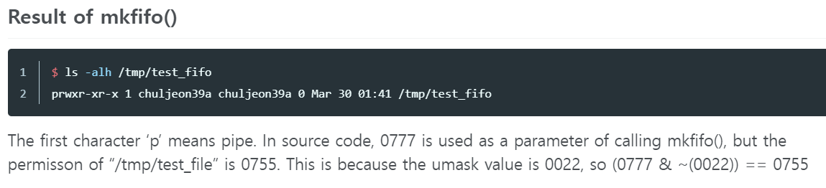


Named pipe creation
To make a named pipe within a C program use include the following C libraries: #include <sys/types.h> #include <sys/stat.h> and to create the named pipe(FIFO) use mkfifo()function: if (mkfifo("test_fifo", 0777)) /* permission is for all */ { perror("mkfifo"); exit(1); }

Slide 51

Unnamed Pipes
The pipe() system call creates an unnamed pipe and opens it for reading and writing
General syntax
int pipe(int fd[2]);
If successful, it will return two integer file descriptors in fd[0] and fd[1]
fd must be an integer array of size 2
The file descriptor in fd[0] is associated with the read end of the pipe and fd[1] is associated with the write end of the pipe
Returns -1 if an error occurred

Slide 52
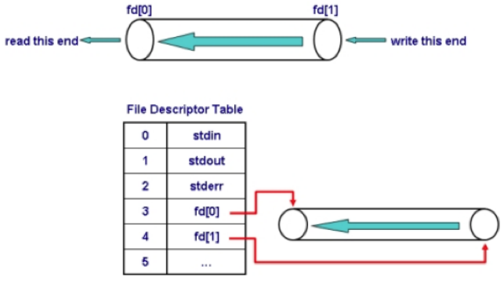

Pipes

Slide 53

Writing to a Pipe
#include <unistd.h>
ssize_t write(int fd, const void *buf, size_t count);
Appends up to count bytes from the end of the pipe referenced by the file descriptor from the buffer
Atomicity guaranteed for requests w/size typically ~ 4096 bytes or less
See PIPE_BUF in /usr/include/linux/limits.h for block size (An operation done by a computer is considered atomic if it is guaranteed to be isolated from other operations that may be happening at the same time)
If write() is done for a pipe not open for reading by any process,
SIGPIPE signal is generated to signify a broken pipe with errno set to EPIPE
SIGPIPE signal is sent to a process when it attempts to write to a pipe whose read end has closed
See man 2 write for more information on this system call

Slide 54

Reading from a Pipe
#include <unistd.h>
ssize_t read(int fd, void *buf, size_t count);
Attempts to read up to count bytes from end of the pipe referenced by the file descriptor from the buffer in a FIFO manner
Returns number of bytes read from the buffer
If read() done for pipe not open for writing by any process, 0 is returned
If read() done for empty pipe open for writing by another process, the process sleeps until the input becomes available
See man 2 read for more information on this system call

Slide 55
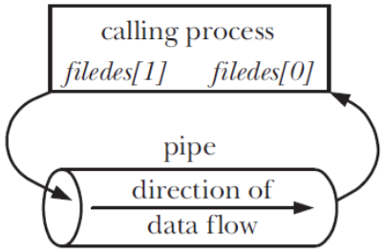

Creating and Using Pipes
Created using pipe():
int filedes[2];
pipe(filedes);
.
.
.
write(filedes[1], buf, count);
read(filedes[0], buf, count);
Pipes are anonymous
There is no name in the file system
But then how do two processes share a pipe?

Slide 56
Unnamed Pipes
Since access to an unnamed pipe is through the file descriptor mechanism, only the process that created the pipe and its descendants may use the pipe (e.g. only parent and child process)
The typical sequence of opening unnamed pipes
The parent process creates an unnamed pipe
It is crucial that this be done before forking
The parent process forks
The writer process closes the read end of the pipe
The reader process closes the write end of the pipe
The processes communicate by using write() and read()
Each process closes its active pipe-end when finished
May be
reversed

Slide 57
Per process FD table
Open file table
i-number or i-node table
Hello.c
Fd
0
1
2
3
Position
Ref count
Position
Ref count
File class.c
Permissions
Type
Size
Blocks
class.c
File hello.c
Permissions
Type
Size
Blocks

Slide 58
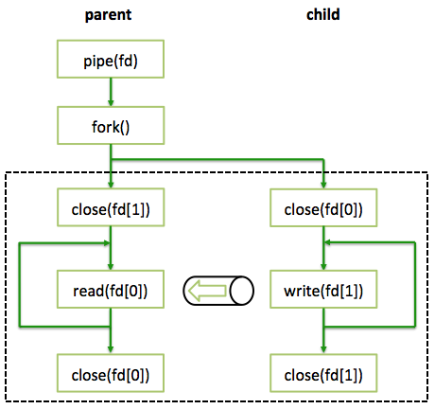
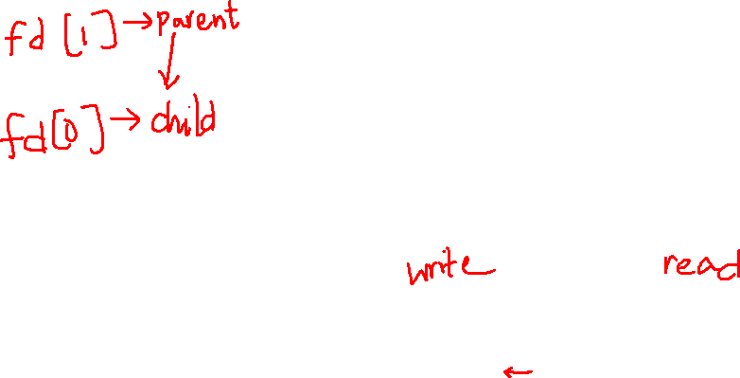
Pipe Communication Scheme

Slide 59
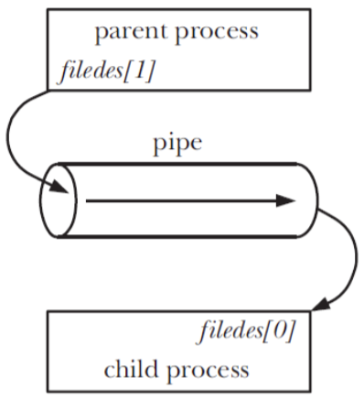

Sharing a Pipe
int filedes[2];
pipe(filedes);
pid = fork();
if (pid == 0) {
close(filedes[1]);
// child now reads
} else {
close(filedes[0]);
// parent now writes
}
The fork() system call duplicates parent’s file descriptors
Parent and child must close unused descriptors – necessary for correct use of pipes
Close writing to the pipe by parent process
Close reading to the pipe by child process

Slide 60

Pipe Example (1)
#include <stdio.h>
#include <string.h>
#include <unistd.h>
#define READ 0 /* The index of the read end of the pipe */
#define WRITE 1 /* The index of the write end of the pipe */
char* phrase = "This goes in the pipe";
int main () {
int fd[2], bytesRead;
char message[100]; /* Parent process' message buffer */
pipe(fd); /* Create unnamed pipe */
if (fork() == 0) /* Child, writer */
{
close(fd[READ]); /* Close unused end */
write(fd[WRITE], phrase, strlen(phrase) + 1); /* Include NULL */
close(fd[WRITE]); /* Close used end */
}
else /* Parent, reader */
{
close(fd[WRITE]); /* Close unused end */
bytesRead = read(fd[READ], message, 100);
printf("Parent just read %i bytes: %s\n", bytesRead, message);
close(fd[READ]); /* Close used end */
}
}

Slide 61
Pipe Example (2)
/* This program will demonstrate what happens if a read takes
place with a pipe whose write end is closed, and vice versa */
#include <stdio.h>
#include <signal.h>
#include <unistd.h>
#include <stdlib.h>
#include <string.h>
#define READ 0 /* The index of the read end of the pipe */
#define WRITE 1 /* The index of the write end of the pipe */
char* phrase = "Another pipe example end closed";
void signal_catcher(int);
int main() {
int fd[2], bytesWritten = 0, bytesRead;
char message[100]; /* Parent process' message buffer */
signal(SIGPIPE, signal_catcher);
pipe(fd); /* Create pipe */
close(fd[WRITE]); /* Close used end */
printf("About to read from pipe\n");
bytesRead = read(fd[READ], message, 100);
printf("%i bytes were read with write closed\n", bytesRead);
close(fd[READ]); /* Close used end */
pipe(fd); /* Recreate unnamed pipe */
close(fd[READ]); /* Close unused end */
printf("About to write to pipe\n");
bytesWritten = write(fd[WRITE], phrase, strlen(phrase) + 1);
printf("%i bytes were written with read end closed\n", bytesWritten);
close(fd[WRITE]);
}
void signal_catcher(int theSig) {
printf("A SIGPIPE (%i) has been caught\n", theSig);
}

Slide 62
dup() System Call
#include <unistd.h>
int dup(int oldfd); E.g.: int file2 = dup(file)
Creates a copy of the oldfd file descriptor with the same open pipe, file pointer, and access mode (R/W etc) in common with the original file descriptor that is set to remain open across the exec family of system calls
Returns the lowest unused file descriptor, -1 if error
Problems if file descriptor returned is not one you are expecting!
A useful system call to convert a stream to a file descriptor
int fileno(FILE *fp);
Note that dup() refers to a file descriptor, not a stream!

Slide 63
Standard file descriptors
Oldfd table
Newfd table
FD | File
0 | STDIN
1 | STDOUT
2 | STDERR
3
4
FD | File
0 | Hello.txt
1 | class.txt
2 | STDERR
3 | savestdin
4
If OS wants to read from a file as input instead of from STDIN (keyboard) you have to first disconnect the terminal from STDIN and connect the file to STDIN to replace it.
savestdin=dup(0);
Dup2(savestdin, 0);

Slide 64
grep –E c$ -
#include <unistd.h>
int main()
{
char *command = { "grep", "-E", "c$", “-”, 0 };
char *bin_file = command[0];
execvp(bin_file, command);
}

Slide 65
#include <unistd.h>
#include <stdio.h>
int main()
{
char *command = { "grep", "-E", "c$", "-", 0 };
char *bin_file = command[0];
if (execvp(bin_file, command) == -1) {
fprintf(stderr, "Error executing %s\n", bin_file);
}
printf("done!\n");
}

Slide 66
Definitions
The OS is a collection of programs, the heart of which is the kernel.
Kernel is the moderator between the applications and resources of the computer.
Kernel provides a set of functions to other programs called system calls.
System calls request access resources of the machine, to communicate with other currently running programs, and to start new programs.
A collection of system calls is sometimes referred to as an application programming interface (API).

Slide 67
dup() Example
int fd[2]; pipe(fd); close(fileno(stdout)); dup(fd[1]);
Since 1 is the lowest fd available, the write end of the pipe is duplicated at fd 1 (stdout)
Now any data written to stdout will be written to the pipe
But you are taking a chance that the file descriptor that will be returned by dup() is what you want
The process may be interrupted between the close() and the dup()
Note that no error checking is done in this example

Slide 68
dup2() System Call
#include <unistd.h>
int dup2(int oldfd, int newfd);
A better alternative to dup() in that it makes the newfd file descriptor as the copy of the old file descriptor atomically, closing newfd first if necessary
There is no time lapse between closing newfd and duplicating oldfd into its spot
Both oldfd and newfd now refer to the same file

Slide 69
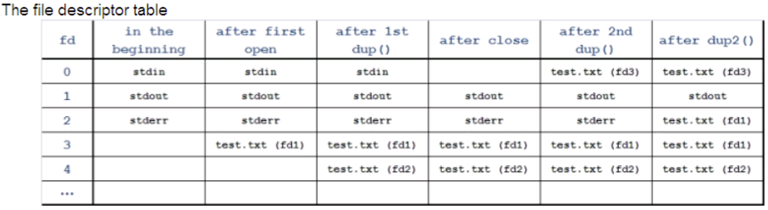
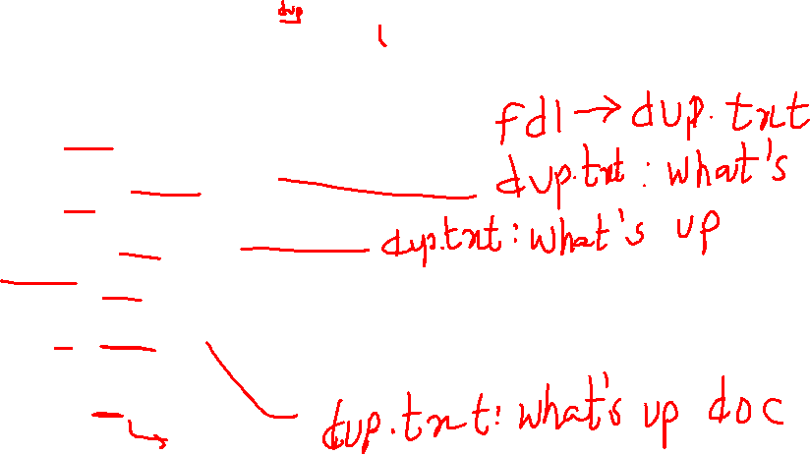
dup() and dup2() Example
/* This program demonstrates the dup and dup2 system calls.
You must have a file present in the directory called "test.txt".
It may be empty or have stuff in it doesn't matter. */
#include <stdio.h>
#include <sys/types.h>
#include <fcntl.h>
#include <sys/file.h>
int main() {
int fd1, fd2, fd3;
fd1 = open(“dup.txt", O_RDWR | O_TRUNC);
printf("fd1 = %i\n", fd1);
write(fd1, "what's", 6);
fd2 = dup(fd1); /* make a copy of fd1 */
printf("fd2 = %i\n", fd2);
write(fd2, " up", 3);
close(0); /* close standard input */
fd3 = dup(fd1); /* make another copy of fd1 */
printf("fd3 = %i\n", fd3);
write(0, " doc", 4); /* because 0 was the smallest file descriptor */
/* and now belongs to fd3 */
dup2(3,2); /* duplicate channel 3 to channel 2 */
write(2, "?\n", 2);
}

Slide 70
dup() and dup2() Example

Slide 71
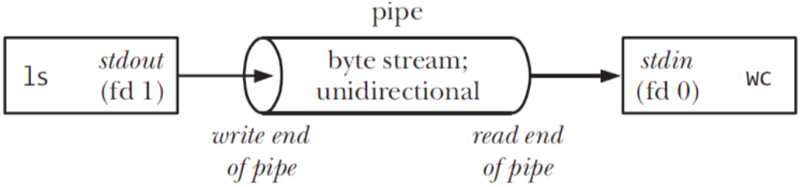
Implement Command-Line Pipe
Can we implement a command-line pipe with pipe()?
E.g., ls –al | wc
How do we attach the stdout of ls to the stdin of wc?
stdin
ls –al
wc
stdout

Slide 72
Implement Command-Line Pipe
fd | After 1st dup2() | After close fd[READ] | After close fd[WRITE] | After 2nd dup2()
0 | Stdin |  |  | fd[READ]
1 | fd[WRITE] | Stdout
2 | Stderr | stderr | stderr
 | Ls -al |  |  | wc
/* Modeling the command-line command: ls -al | wc using pipes */
#include <stdio.h>
#include <stdlib.h>
#include <unistd.h>
enum { READ, WRITE };
int main() {
int fd[2];
if (pipe(fd) == -1) { /* generate the pipe */
perror("Pipe");
exit(1); }
switch (fork()) {
case -1: perror("Fork");
exit(2);
case 0: /* in child */
dup2(fd[WRITE], fileno(stdout));
close(fd[READ]);
close(fd[WRITE]);
execl("/bin/ls", "ls", "-al", (char *)0 );
exit(3);
default: /* in parent */
dup2(fd[READ], fileno(stdin));
close(fd[READ]);
close(fd[WRITE]);
execl("/usr/bin/wc", "wc", (char *)0 );
exit(4);
}
return 0;
}
dup2(int oldfd, int newfd);
Stdin→ ls –al → wc → stdout

Slide 73
Implement Redirection
When a process forks, the child inherits a copy of its parent's file descriptors
When a process execs, all non-close-on-exec file descriptors remain unaffected
This includes stdin, stdout, and stderr
To implement redirection, the shell simply does the following
The parent shell forks then waits for the child shell to terminate

Slide 74
Implement Redirection
fd | After open() | After 1st dup2() | After close
0 | Stdin
1 | stdout
2 | Stderr
3 | Hello.txt
4
/* The program demonstrates implementing redirection.
To run: ./a.out <output filename> <command>
*/
#include <stdio.h>
#include <sys/file.h>
#include <sys/types.h>
#include <sys/stat.h>
#include <fcntl.h>
int main(int argc, char* argv[])
{
int fd;
/* Open file for redirection */
fd = open(argv[1], O_CREAT | O_TRUNC | O_WRONLY, 0600);
dup2(fd, 1); /* Duplicate descriptor to standard output */
close(fd); /* Close original descriptor to save descriptor space */
execvp(argv[2], &argv[2]); /* Invoke program; will inherit stdout */
perror("main"); /* Should never execute */
}
Argv[1]
Argv[2]

Slide 75
Implement Redirection
The child shell opens the file, say ls.out, creating it or truncating it as necessary
The child shell then
Duplicates the file descriptor of ls.out to the standard output file descriptor (fd 1)
Closes the original file descriptor of ls.out
All standard output is therefore directed to ls.out
The child shell then execs the ls utility
Since the file descriptors are inherited during an exec, all stdout of ls goes to ls.out
When the child process terminates, the parent resumes
The parent's file descriptors are unaffected by the child's action as each process maintains its own descriptor table

Slide 76
Implement Pipe and Redirection
/* Equivalent to "sort < file2 | uniq */
#include <stdio.h>
#include <stdlib.h>
#include <unistd.h>
int main() {
int fd[2];
FILE *fp = fopen("file2", "r");
dup2(fileno(fp), fileno(stdin));
fclose(fp);
pipe(fd);
if (fork() == 0) {
dup2(fd[1], fileno(stdout));
close(fd[0]);
close(fd[1]);
execl("/usr/bin/sort", "sort", (char*) 0);
exit(2);
} else {
dup2(fd[0], fileno(stdin));
close(fd[0]);
close(fd[1]);
execl("/usr/bin/uniq", "uniq", (char*)0);
exit(3);
}
return 0;
}

